Slide 1
Coptic Lesson 20 Future Tense

Slide 2
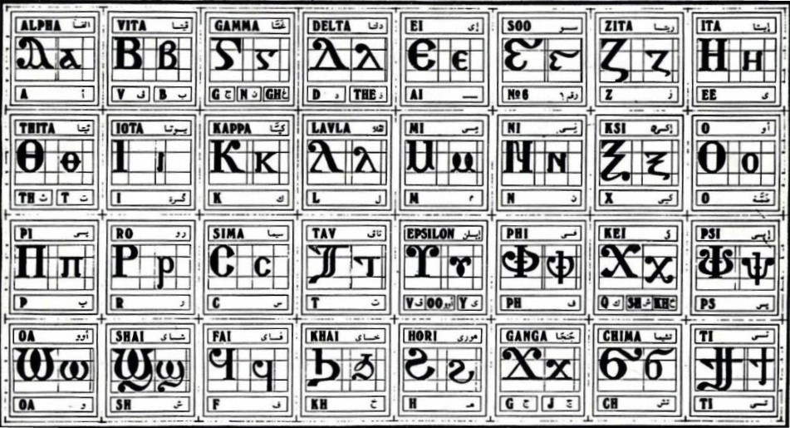
Coptic Alphabets

Slide 3
Review Questions
Coptic
Name
English
=,=e
,ere
Greetings
==e=;=u
`e;ouab
holy
I=l=y=m
Ieroucalym
Jerusalem
=x=y
ce-`smyn
68
=f=d
pictau-`ftoou
94
=I=c=l
Icrayl
Israel
=r=n
Se-tebi
150

Slide 4
Rule for the Kei <:
k
(in a Coptic Word)
< , =
sh
(Gk, before the e-family)
e-family:
e> y> i> u
kh
(Gk, otherwise)
Examples:
,ymi
,aric
,ere
`,rwm
Ar,y
Mona,oc
,w
Lu,nia
Pi,iwn
,wra
Ic,uroc

Slide 5
Vocabulary List
`i
to come
cwtem
to hear
nehci
to wake up
jimi
to find
mou
to die
enkot
to sleep
rasi
to rejoice

Slide 6
Coptic Bible Verses – Part 3
Rasi qen `P[oic `ncyou niben Rejoice in the Lord always. (Phil 4:4)
Twbh `ejen neten`eryou Pray for one another. (Jm 5:16)
Vnou] ouagapy pe God is love. (I Jn 4:16)
Jemnom] anok ai[ro `epikocmoc Be of good cheer, I have overcome the world. (Jn 16:33)
}ar,y `n]covia ]ho] `nte `P[oic te The fear of the Lord is the beginning of wisdom. (Ps 110:10)

Slide 7
Beginner Vocabulary Review
romi kahi `Vnou] `alou ioh
ry con syri iwt bal
yi ran ro ouro nyb
`chimi vorsi seri ourw ri
cwni ajp ve sau soury
mau ]`alou jij `;nyb hiomi
nicwni nirwmi niran nimau ni`alou
jom niourw nibal nisau ninyb
niseri totc io] ourwou vyou`i

Slide 8
Future Tense
]na`i
`,na`i
tena`i
`fna`i
`cna`i
tenna`i
tetenna`i
cena`i
I will come
you will come (masculine)
you will come (feminine)
he will come
she will come
we will come
you will come (plural)
they will come

Slide 9
Exercise (Part 1)
Use the following verbs to form a future tense:
ka]
to understand
mosi
to walk
`slyl
to pray
menre
to like
sari
to hit
cw
to drink
ouws `e
to want to
moc]
to hate

Slide 10
Exercise (Part 2)
Translate the following into English:
]na] `mpajwm
I will give my book.
]namosi nem nai`cnyou
I will walk with these borthers.
ni`cnyou cena`slyl
The brothers will pray.
Pairwmi `fna]
This man will give.
tennanehci ouoh tenna`slyl
We will wake up and we will pray.
cenaka] `mpiws
They will understand the lesson.
paiwt `fna`i `nrac]
My dad will come tomorrow.

Slide 11
Announcement
All slides are available at http://www.ekladious.com/coptic.html

Slide 12

Oujai qen `P[oic

